Slide 1

Research on Agfa and ORWO magnetic sound materials in the collection stock of Potsdam Film Museum
Adele Bosi^{1,2}, Caroline Figueroa³, Siobhan Piekarek², Elisabeth von Galen², Ulrich Rüdel³
¹ “Sapienza” University of Rome, Piazzale Aldo Moro 5, 00185 Rome, Italy
² Potsdam Filmmuseum Collection, Pappelallee 20, 14469 Potsdam, Germany
³ University of Applied Science, Wilhelminenhofstraße 75A, 12459 Berlin, Germany

Slide 2
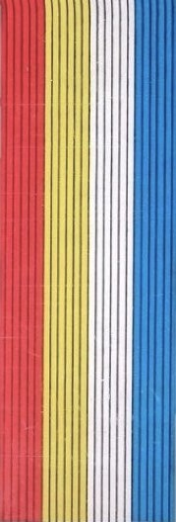
Magnetic sound recording
Invented in 1898
Used after 1940 [1]
Magnetic sound material can be
COMMAG
SEPMAG [2]

Slide 3
They are composed by:
BASE (cellulose-acetate, polyvinyl chloride, polyester)
MAGNETIC LAYER (pigment, binder and additives)
BACK-COATING (pigment and binder)

Slide 4
CELLULOSE-ACETATE (CA)
Used as a base until 1970s [1, 2]
Suffers from well known “Vinegar Syndrome”, which produces ACETIC ACID

Slide 5
POLYESTER
Polyethylene-terephthalate (PET) used since 1950s [1,2]
Very strong, inert and durable
No degradation processes observed, but…

Slide 6
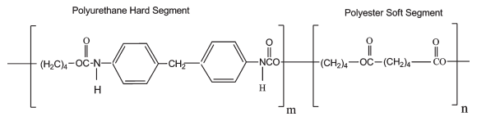
POLYESTER-URETHANE (PU)
Used as a binder on PET since 70s [3]
Separated into “HARD SEGMENTS”, and “SOFT SEGMENTS” [4]

Slide 7
It undergoes degradation through
HYDROLYSIS
STICKY SHED SYNDROME
UNIDENTIFIED PROBLEMS

Slide 8

HYDROLYSIS
Produces alcohol and carboxylic acid
The produced ACID further catalyses the reaction [5]

Slide 9
It produces:
Change in tape’s mechanical and physical properties [4]
Decrease in glass transition temperature [5]

Slide 10
STICKY SHED SYNDROME (SSS)
Causes stickiness, magnetic layer shedding [2], squealing sound and loss of high frequencies [4]
Mechanism involved is not so clear yet

Slide 11
Involves soft PU segments, decrease of H-bonded carbonyl groups
It seems to involve BACK-COATED tapes
Archivists and restorers BAKE SSS magnetic tapes for 5-8 h at 54 C° [4]

Slide 12
Other UNIDENTIFIED PROBLEMS don’t respond to baking
Mechanism involved is not so clear yet
They cause stickiness and squealing also in non back-coated tapes, but they don’t cause shedding [3]

Slide 13
…a little bit of general DISAGREEMENT about PU decay processes classification and mechanisms.
Further STUDIES would be needed.

Slide 14
[1] “ARSC Guide to Audio Preservation”, 2015
[2] “Study of Source Material and Consideration on the Preservation of SEPMAG Tapes”, Katrin Abromeit, 2011
[3] “FACET Format Characteristics and Preservation Problems” Version 1.0, Mike Casey, 2007
[4] “Analysis of Audio Magnetic Tapes with Sticky Shed Syndrome by ATR-FTIR”, Hobaica, 2012
[5] “EFFECT OF HYDROLYSIS ON MOLAR MASS AND THERMAL PROPERTIES OF POLY(ESTER-URETHANES)” by A. Pegoretti, A. Penati and J. Kolarfk, 1994

Slide 15
90% of Potsdam Film Museum collection is Agfa and ORWO material
ROOM 13 and ROOM 08 store magnetic sound materials.
These rooms have been noticed to occur strange odor.

Slide 16
History of Agfa and ORWO magnetic sound materials started during 1930s:
1930s Aktiengesellschaft für Anilinfabrikation (Agfa) became interested in using BASF Magnetophon C
1943 Agfa Wolfen Magnetband Typ C in CA first started to be produced [2] while BASF started selling PVC Magnetophon L (=Luvitherm) [1]

Slide 17
1946 Agfa Film Factory in Wolfen was incorporated in Soviet Enterprises “Photoplenka” [3]
1950s Agfa Wolfen started experiments for production of PET tapes[4]. A lot of material experiments started because of lack of equipment due to the separation of Germany [2]

Slide 18
1964 the Film Factory sold its trademark rights to the sister company Agfa Gevaert and changed its name in ORWO (=Original Wolfen) [5]
1968 the first PET tapes PS 25 U 6 and PS 18 U 6, were first sold [4]
1974 ORWO stopped production of CA tapes [4]
1994 magnetic tapes production in Wolfen stopped [2]

Slide 19
In Potsdam Film Museum Collection one every ten sound material boxes has been opened and checked.

Slide 20
18 different types:
ROOM 13 (Amateur tapes) |  | ROOM 08 (Professional tapes)
TYP | NR | TYP | NR
Typ C | 13 | CPS 35 U 6 | 1
Typ CR | 4 | Typ CR | 1
CPR | 1 | CPR | 1
CR 35 U 6 | 1 | Typ CH | 3
CPR 50 U 6 | 7 | CPR 50 U 6 | 3
Typ 103 | 2 | Typ 103 | 5
Typ 104 | 2 | Typ 104 | 25
Typ 106 | 1 | Typ 106 | 17
Typ 115 | 30 | Typ 115 | 6
Typ 121 | 2 | Typ 100 | 2
PS 18 U 6 | 4 | Typ 114 | 1
Typ 207 LN | 1 | Typ 116 | 1
Typ 205 LN | 1

Slide 21
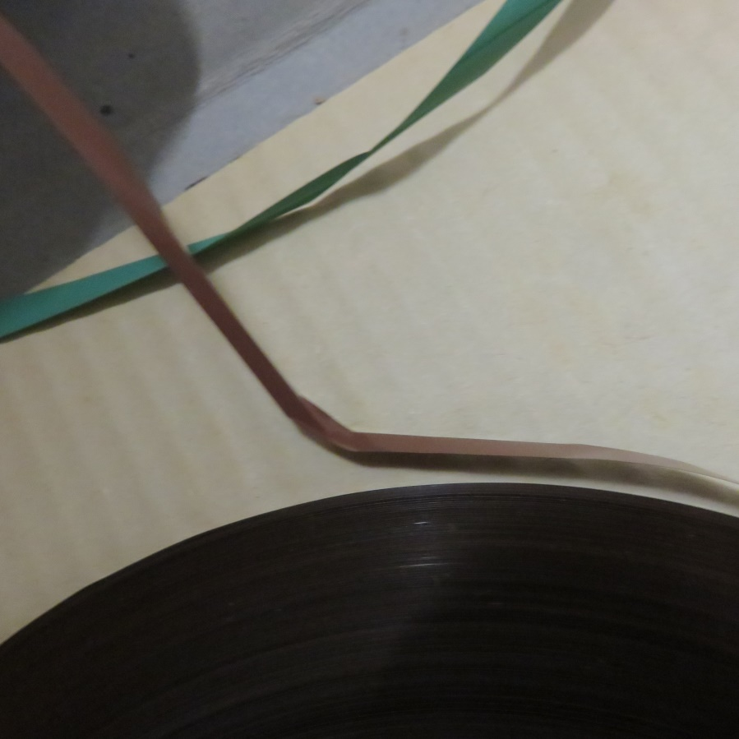
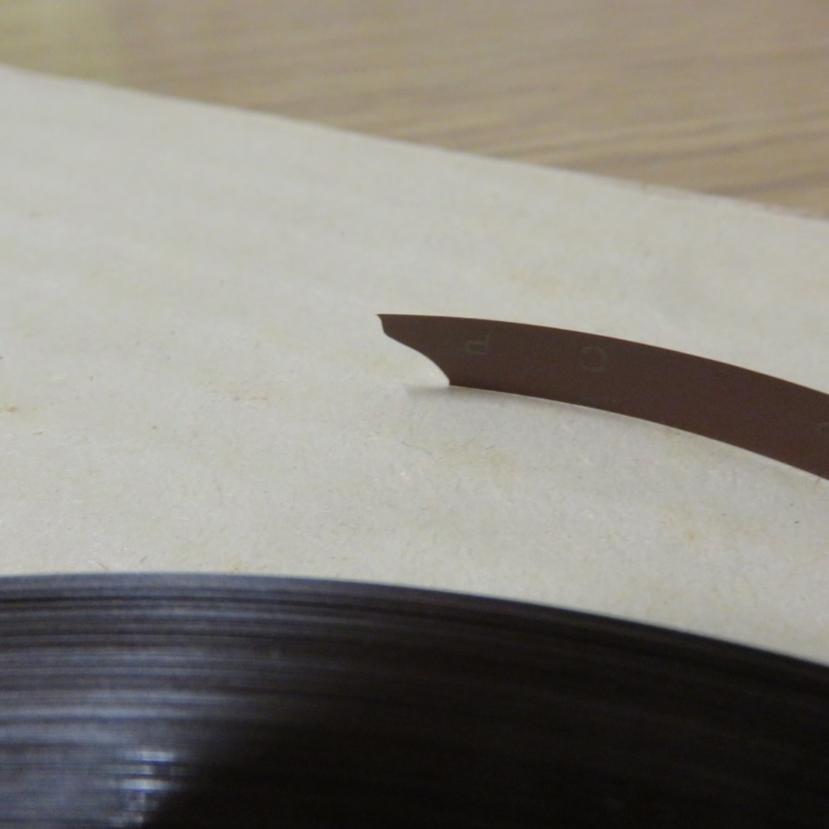
To a visual inspection, a lot of tapes seem to be in good condition.
Nevertheless, the older ones are usually very brittle and curl, sometimes broken.

Slide 22
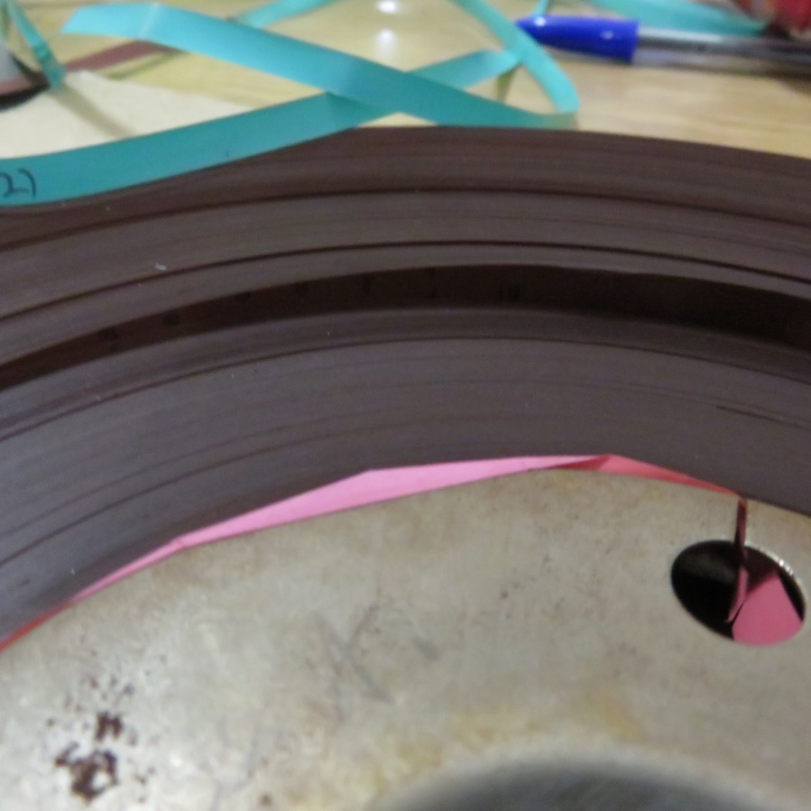
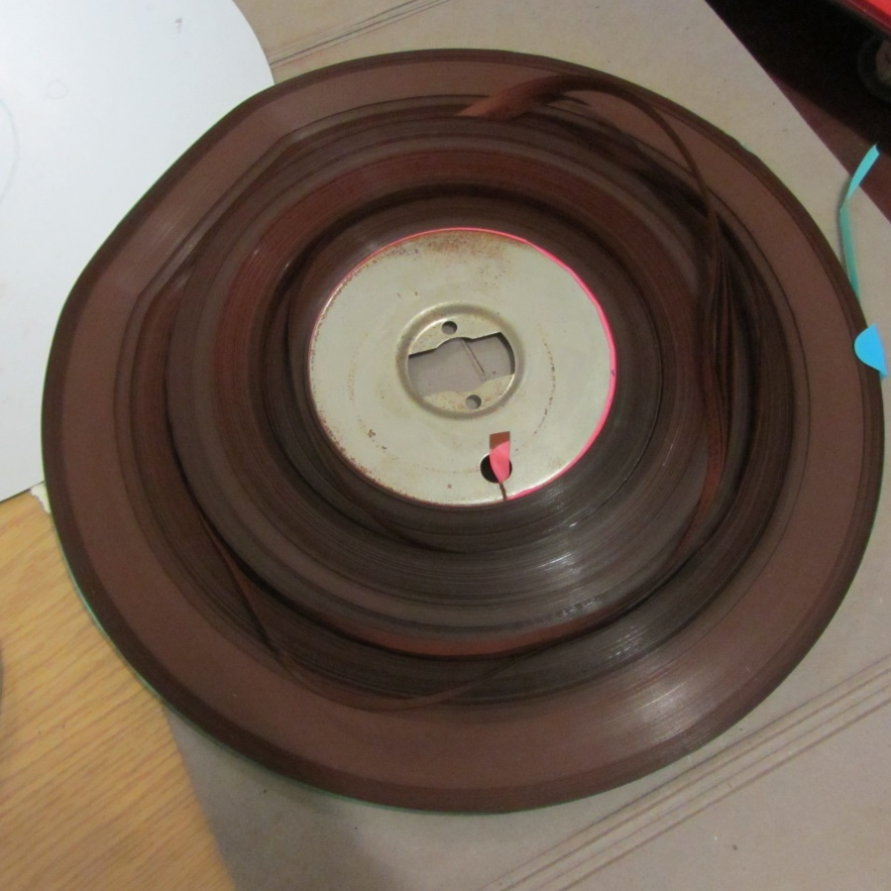
Some of them, especially CPR 50 U 6, have popped strands and windowing.

Slide 23
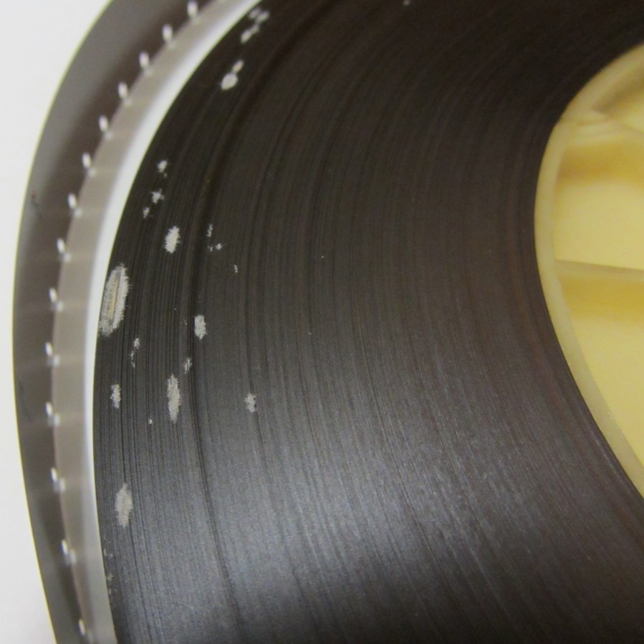
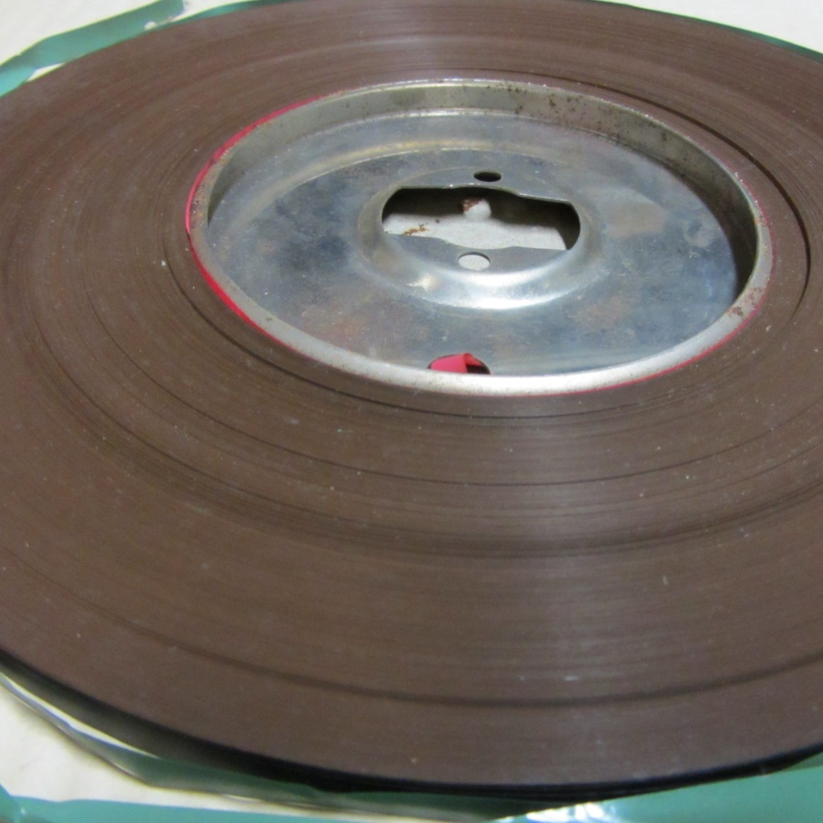
Some tapes have fungus, and some other ones have different spots which look like they are inside the material.

Slide 24
PU problems are difficult to recognize without playing the tape
Knowledge about composition is needed.

Slide 25
If neglected, PU problems will worsen and become visible, and lead to a loss of tapes information.
The PET/PU SEPMAG of «Christoph und Dorina» film, is completely sticky and unplayable.

Slide 26
Research in INDUSTRIE UND FILMMUSEM WOLFEN archive
In CHEMIEPARK, in Bitterfeld-Wolfen industrial area
Agfa and ORWO Filmfabrik, where key developments in film materials and processes were brought

Slide 27
Agfa and ORWO sound materials brochures
Historical information
Nomenclature method
Recipes
Letters
Production plans
Material experiments plans
Confidential documents

Slide 28
Nomenclature
CPS 50 U 6
(before 1969)
Typ 100
(after 1969)

Slide 29
Archive documents + Nomenclature system knowledge + FTIR-ATR analysis: information about tape types present in Film Museum stock

Slide 30
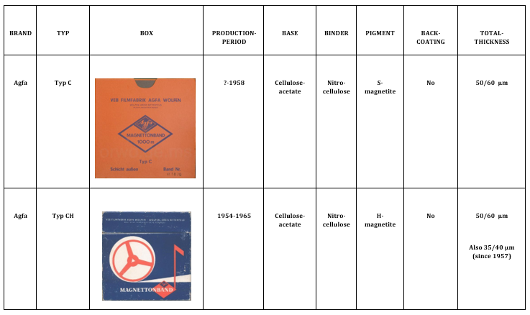

Slide 31
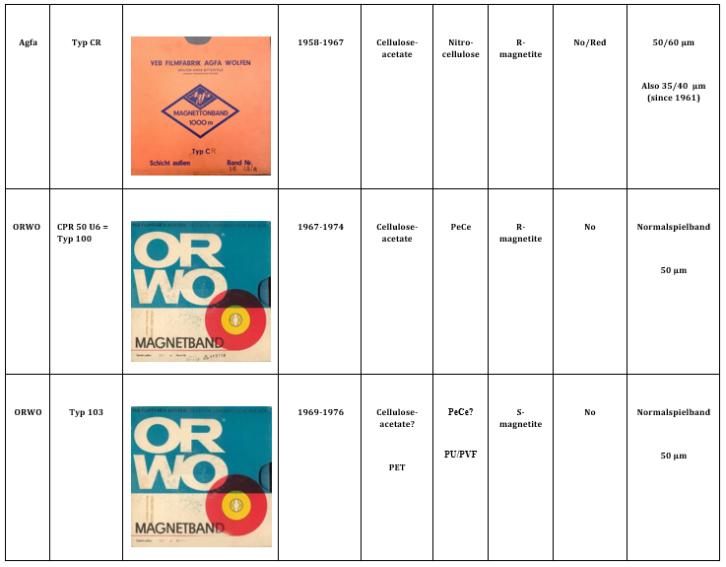

Slide 32
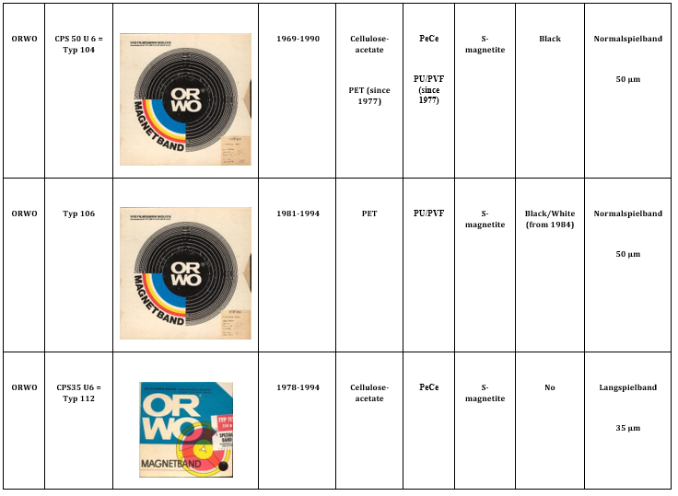

Slide 33
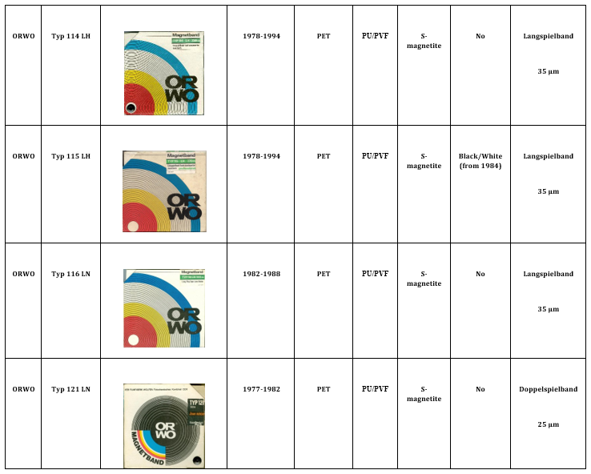

Slide 34
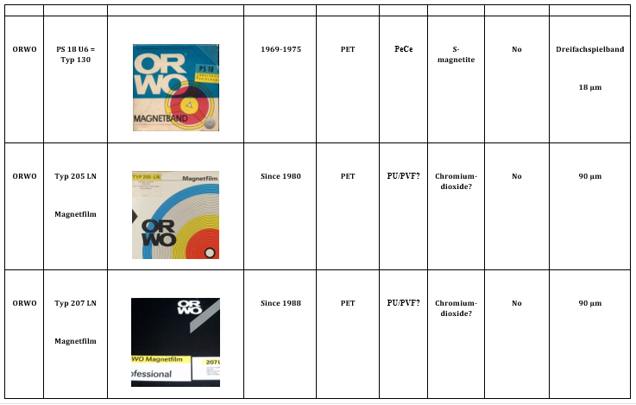

Slide 35
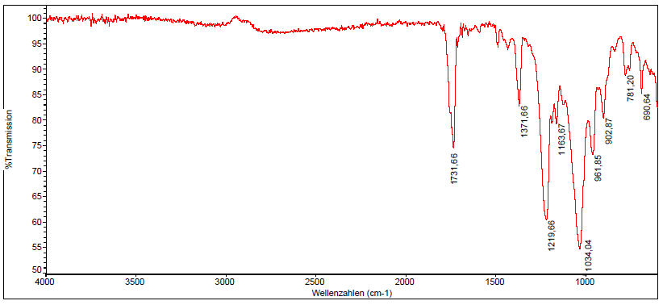
FTIR Spectrometer PU 9800 Philips, Diamant ATR
Scan number: 32, Resolution: 4cm⁻¹, Software: OMNIC
ATR-FTIR spectum of Typ C, base layer (cellulose-acetate)

Slide 36
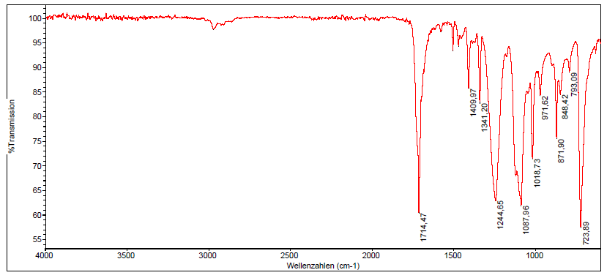
FTIR Spectrometer PU 9800 Philips, Diamant ATR
Scan number: 32, Resolution: 4cm⁻¹, Software: OMNIC
ATR-FTIR spectum of Typ 114, base layer (polyethylene-terephthalate )

Slide 37
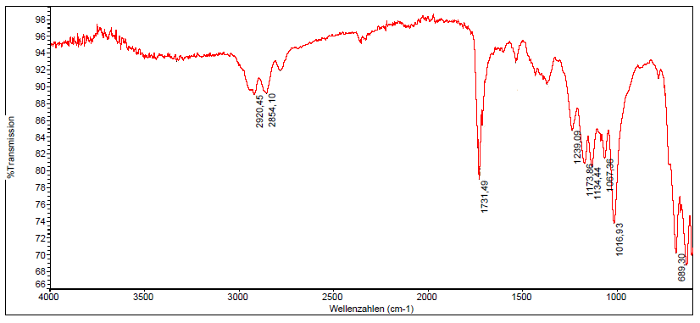
FTIR Spectrometer Philips PU 9800, Diamant ATR
Scan number: 32, Resolution: 4cm⁻¹, Software: OMNIC
ATR-FTIR spectum of Typ 116, magnetic layer (polyurethane and polyvinylformal)

Slide 38
Some questions are however still open:
Are there in Potsdam Film Museum stock PU affected PET tapes?
What kind of PU problem does “Christoph und Dorina” have?
Is it possible to understand different PU decays mechanism by FTIR?

Slide 39
Which are causes?
Which role does back-coating play?
Is it possible to avoid?
Should be CA and PET stored separately?

Slide 40
Useful data acquired
PU problems mechanisms and causes need to be further understood to try to develop a suitable conservation strategy.

Slide 41
[1] “Magnetic Tape from the Early Days to the Present” by FRIEDRICH KARL ENGEL, 1988
[2] Documents in Wolfen Museum Archive, 572
[3] https://www.chemiepark.de/en/der-chemiepark/historie/
[4] “Die Filmfabrik Wolfen Aus der Geschichte” Heft 6
[5] http://www.orwonet.de

Slide 42
